Slide 1
Course Title - Web System Engineering
Topic Title - Introduction to client-side routing using React Router
Presenter’s Name - M ArunKumar
Presenter’s ID - IARE11151
Department Name - CSE ( Artificial Intelligence, and Machine Learning )
Lecture Number - #
Presentation Date - ##/03/2025

Slide 2
Introduction to client-side routing using React Router
Client-side routing is a key concept in modern web development, where we handle navigation and URL changes without having to reload the entire page.
What is React Router?
React Router is a routing library for React that enables you to manage navigation and views in a single-page application. Instead of loading new HTML pages from the server when a user clicks a link, React Router changes the view directly in the browser, updating the URL accordingly, but without a full page reload.

Slide 3
Introduction to client-side routing using React Router
Introduction to client-side routing using React Router:
We wouldn’t always “single page” app
EX: Facebook.com
Facebook.com/profile
Facebook.com/messages/12345

Slide 4
Introduction to client-side routing using React Router
This is 2 Ways
Server side
Client side
React router allows us to handle the user navigation (at client side ) from our react app.

Slide 5
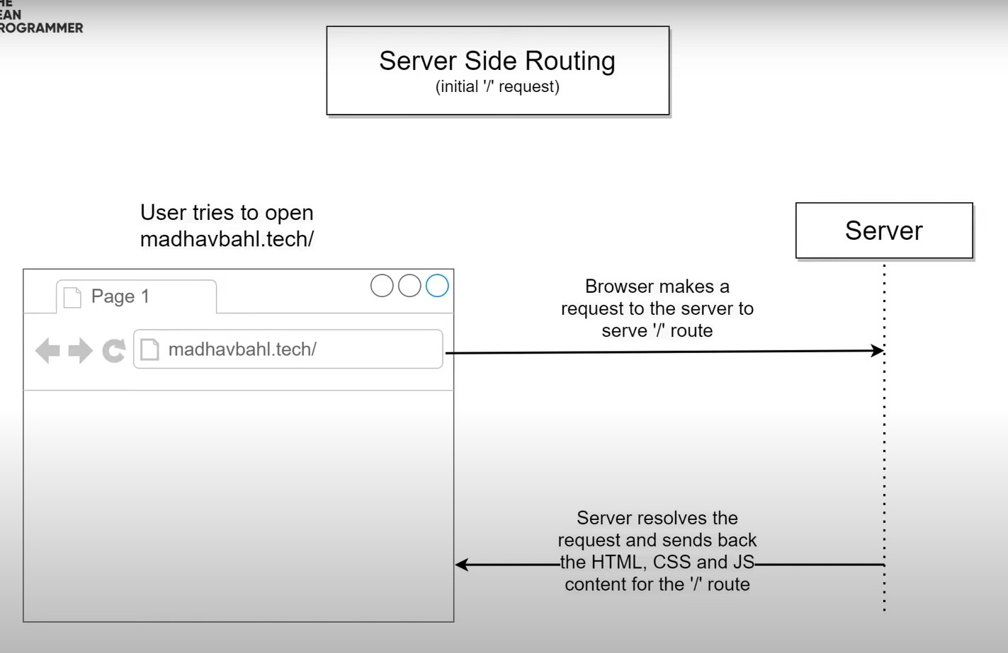
Introduction to client-side routing using React Router

Slide 6
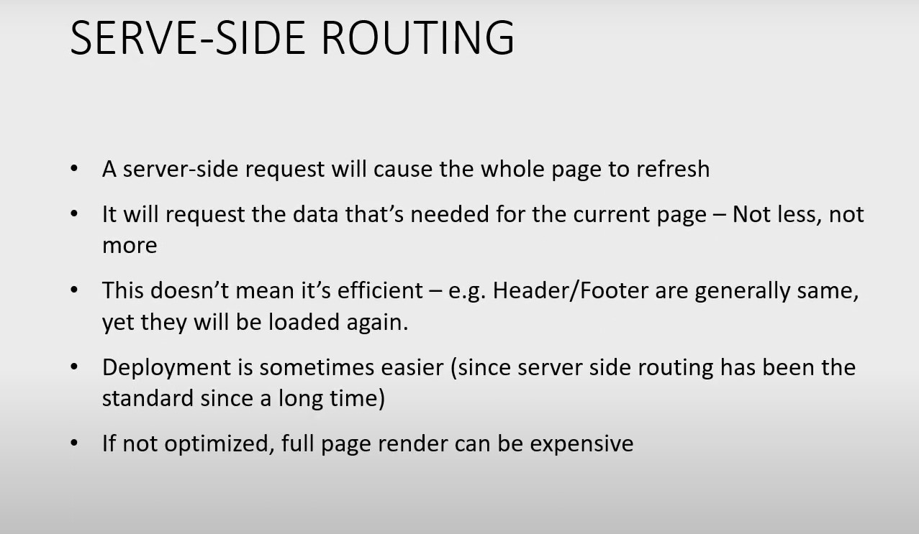
Introduction to client-side routing using React Router

Slide 7
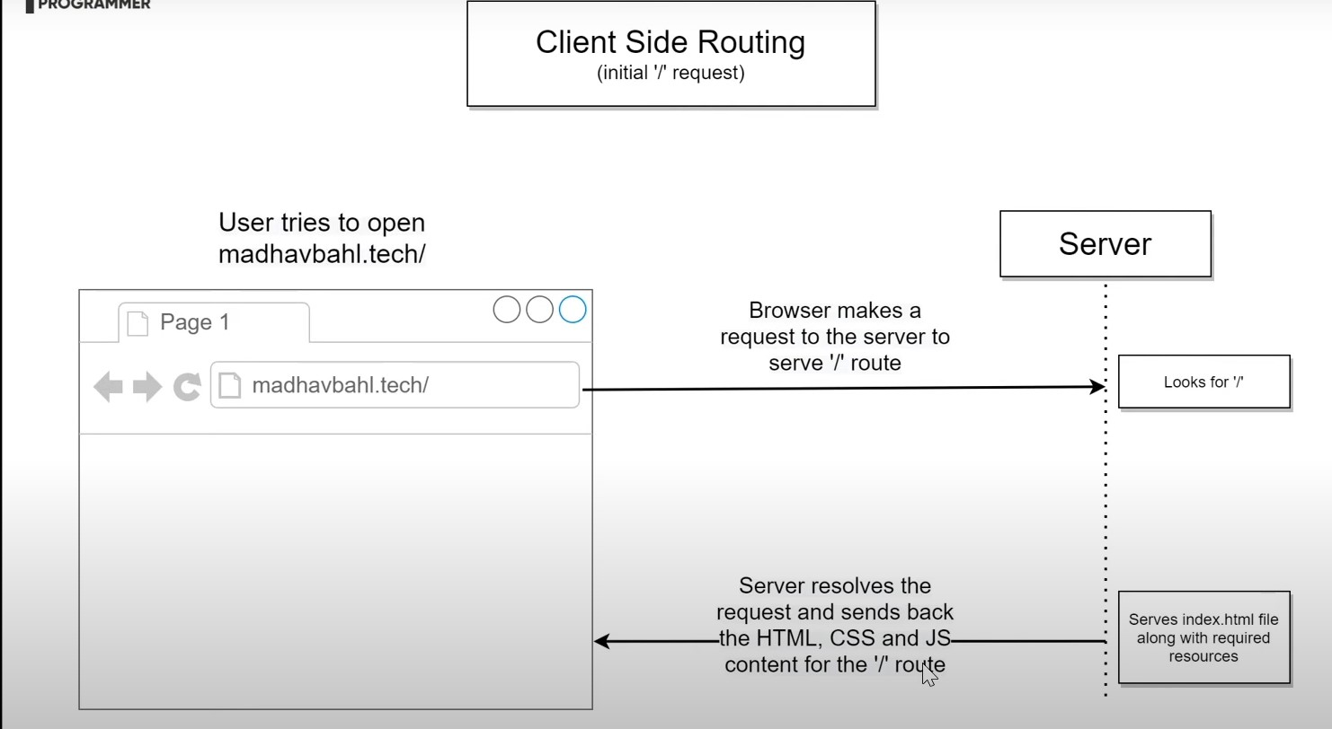
Introduction to client-side routing using React Router

Slide 8
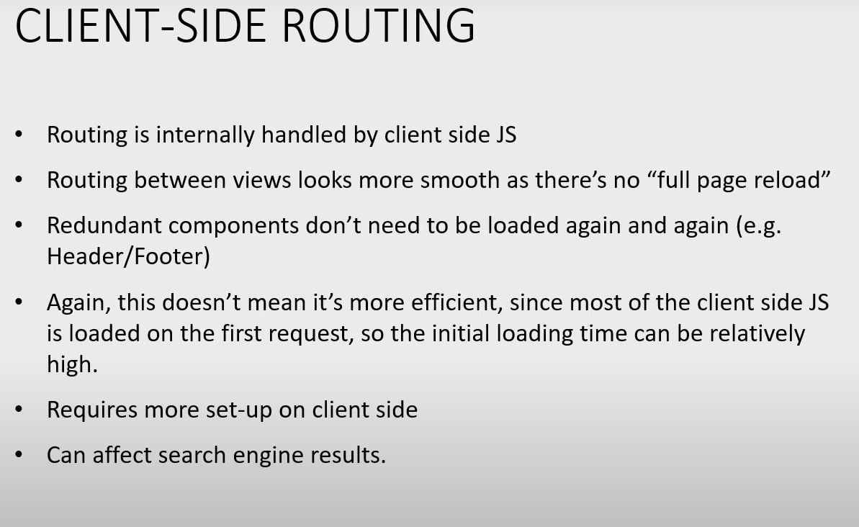
Introduction to client-side routing using React Router

Slide 9
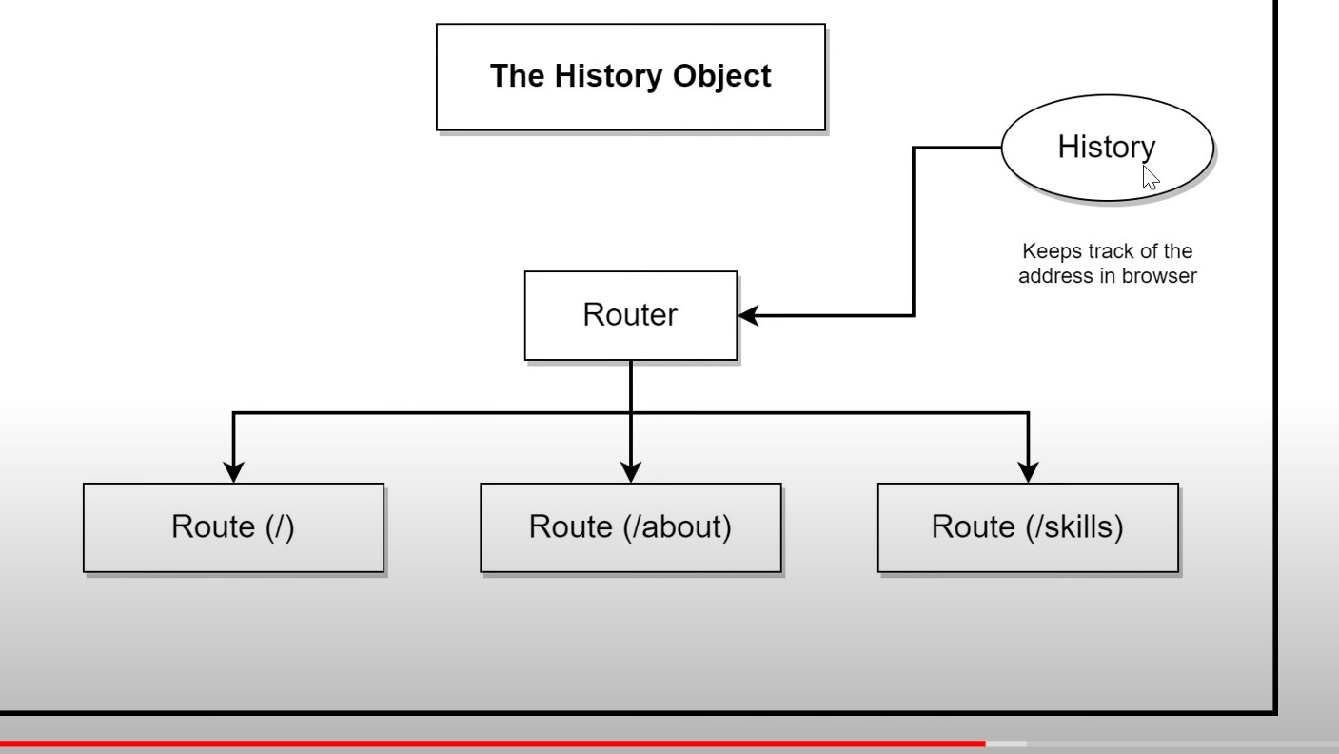
Introduction to client-side routing using React Router

Slide 10
Thank You

